Slide 1
CHAPTER 6
Techniques of Integration

Slide 2
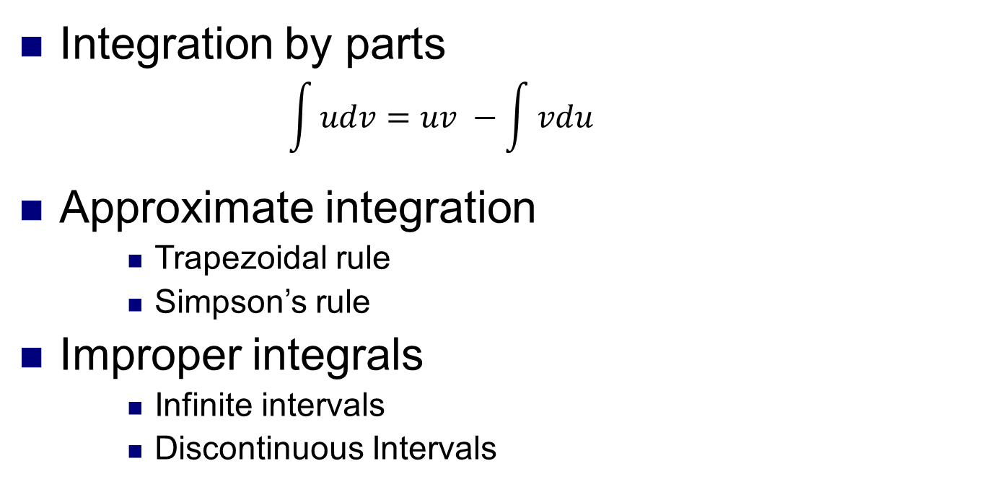
CHAPTER 6
Integration by parts
$$\int{udv}=uv −\int{vdu}$$
Approximate integration
Trapezoidal rule
Simpson’s rule
Improper integrals
Infinite intervals
Discontinuous Intervals

Slide 3
We summarize here the most important integrals that we have learned so far.

Slide 4
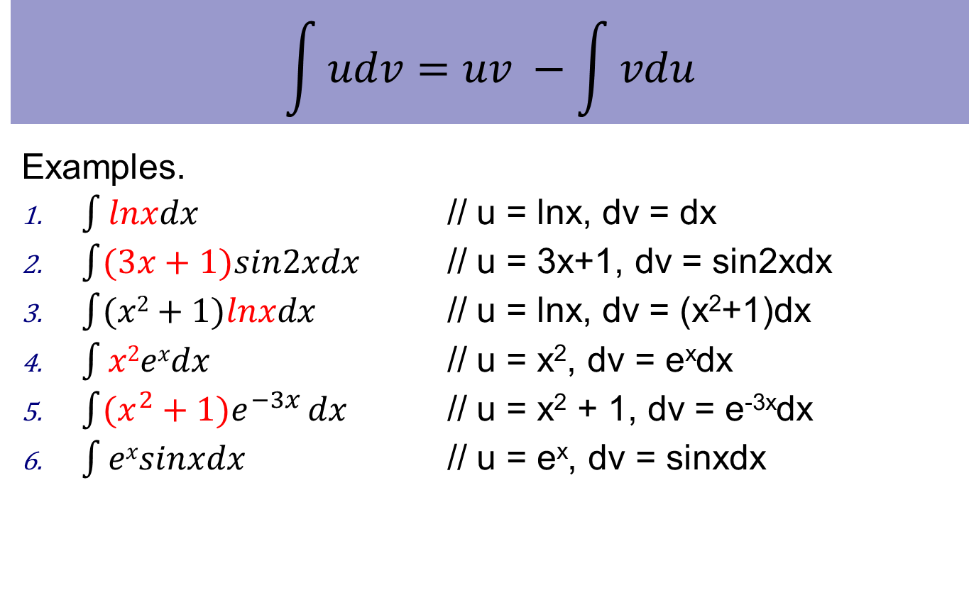
Integration by parts
$$\int{udv}=uv −\int{vdu}$$
Examples.
$\int{lnxdx}$ // u = lnx, dv = dx
$\int{(3x+1)sin2xdx}$ // u = 3x+1, dv = sin2xdx
$\int{(x2+1)lnxdx}$ // u = lnx, dv = (x²+1)dx
$\int{x2exdx}$ // u = x², dv = e^{x}dx
$\int{(x^{2}+1)e^{−3x}}dx$ // u = x² + 1, dv = e^{-3x}dx
$\int{exsinxdx}$ // u = e^{x}, dv = sinxdx

Slide 5

Improper integrals
Type 1: infinite intervals
$\int_{a}^{∞}{f(x)}dx$, $\int_{−∞}^{b}{f(x)}dx$, $\int_{−∞}^{∞}{f(x)}dx$
Type 2: discontinuous Integrands

Slide 6
Type 1

Slide 7
Definition

Slide 8
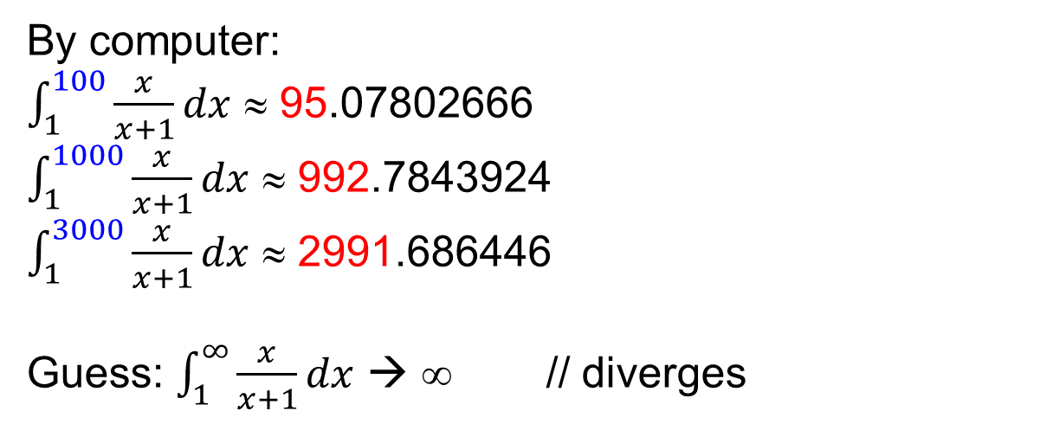
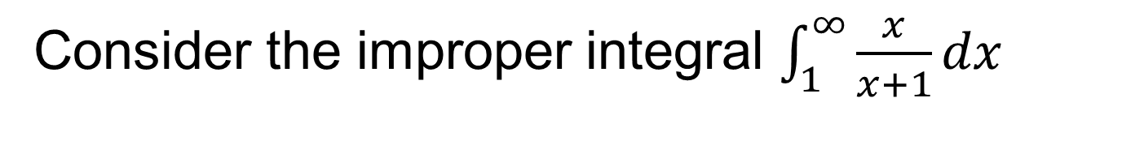
Type 1. Example 1
Consider the improper integral $\int_{1}^{∞}{\frac{x}{x+1}}dx$
By computer:
$\int_{1}^{100}{\frac{x}{x+1}}dx$ ≈ 95.07802666
$\int_{1}^{1000}{\frac{x}{x+1}}dx$ ≈ 992.7843924
$\int_{1}^{3000}{\frac{x}{x+1}}dx$ ≈ 2991.686446
Guess: $\int_{1}^{∞}{\frac{x}{x+1}}dx$ → ∞ // diverges

Slide 9

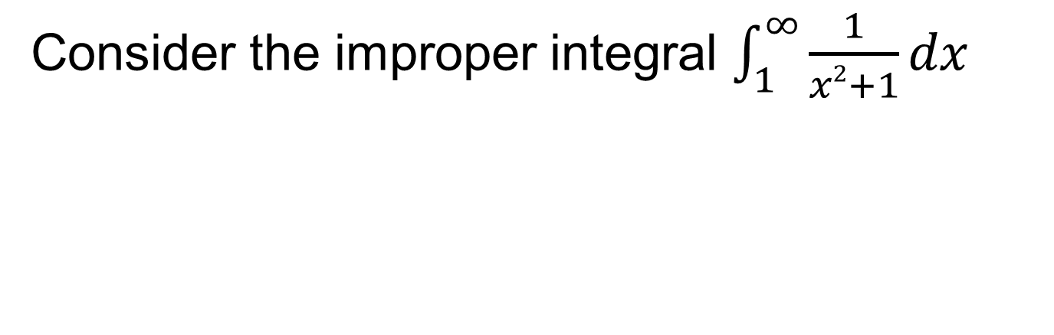
Type 1. Example 2
Consider the improper integral $\int_{1}^{∞}{\frac{1}{x2+1}}dx$
By computer:
$\int_{1}^{100}{\frac{1}{x2+1}}dx$ ≈ 0.7753984965
$\int_{1}^{1000}{\frac{1}{x2+1}}dx$ ≈ 0.7843981635
$\int_{1}^{3000}{\frac{1}{x2+1}}dx$ ≈ 0.7850648295
Guess: $\int_{1}^{∞}{\frac{1}{x2+1}}dx$ → a number // converges

Slide 10
CONVERGENT AND DIVERGENT
The improper integrals is called:
Convergent (hội tụ) if the corresponding limit exists.
Divergent (phân kì) if the limit does not exist.

Slide 11
Ex1.
State whether the improper integral converges or diverges
Ex2.
Ex3.
Ex 4.

Slide 12

Type 1.
$$\int_{1}^{∞}{\frac{1}{x^{p}}}dx$$
p > 1: converges
p ≤ 1: diverges
Important for future reference

Slide 13
IMPROPER INTEGRAL OF TYPE 2
If f is continuous on [a, b) and is discontinuous at b, then
if this limit exists (as a finite number).

Slide 14
IMPROPER INTEGRAL OF TYPE 2
If f is continuous on (a, b] and is discontinuous at a, then
In each case, if the limit exists, then the improper integral is said to converge. If the limit does not exist, then the improper integral is said to diverge.

Slide 15
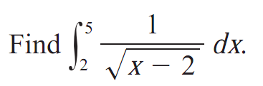
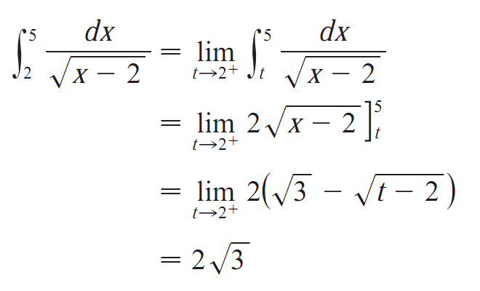
Type 2. Example

Slide 16
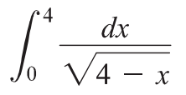
Type 2. Do yourself

Slide 17
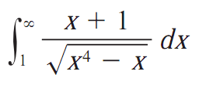


Comparison with $\int_{1}^{∞}{\frac{1}{x^{p}}}dx$
A Comparison Theorem
∼ $\int_{1}^{∞}{\frac{x}{\sqrt{x^{4}}}}dx$ = $\int_{1}^{∞}{\frac{1}{x}}dx$ ➔ divergent

Slide 18


Comparison. Do yourself

Slide 20
Approximate integration
Trapezoidal rule
Simpson’s rule

Slide 21
The Midpoint Rule
[a, b] is divided into n subintervals, each of length Δx, and mi is the midpoint of the ith subinterval, set
EX.

Slide 22
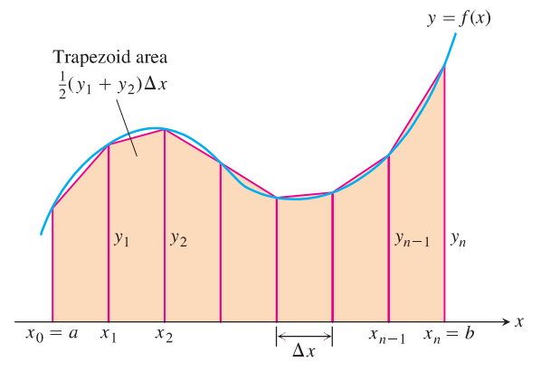
TRAPEZOIDAL RULE
The area of the trapezoid that lies above the i th subinterval is:
Trapezoidal rule
// add up all areas

Slide 23

Trapezoidal rule. Example
The function f is continuous on [3, 10] and has values given in the table below. Using the intervals [3, 5], [5, 8], [8, 10],
Find the trapezoidal approximation of $\int_{3}^{10}{f(x)}dx$
EX1.
x | 3 | 5 | 8 | 10
f(x) | 17 | 12 | 3 | -7
EX2.

Slide 24
SIMPSON’S RULE
This is called Simpson’s Rule—after the English mathematician Thomas Simpson (1710–1761).

Slide 25
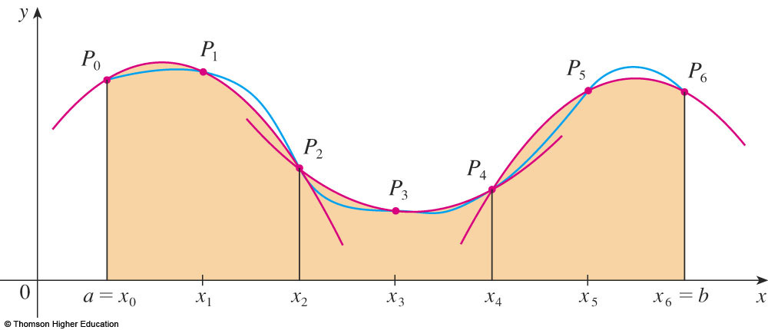
SIMPSON’S RULE
where n is even and ∆x = (b – a)/n.

Slide 26
Applying Simpson’s Rule
Ex 1.
Ex 2.

Slide 27
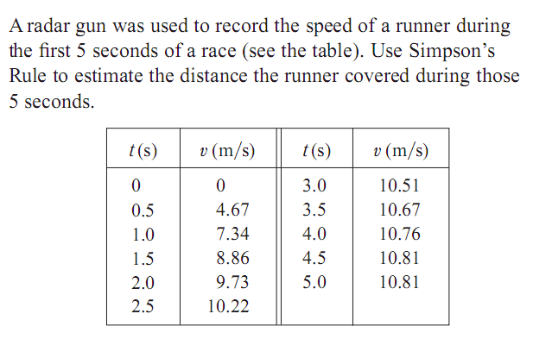
Simpson’s rule

Slide 28
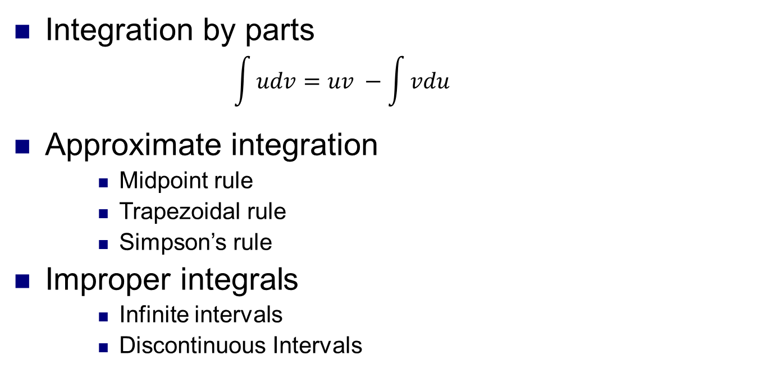
Summary
Integration by parts
$$\int{udv}=uv −\int{vdu}$$
Approximate integration
Midpoint rule
Trapezoidal rule
Simpson’s rule
Improper integrals
Infinite intervals
Discontinuous Intervals

